Slide 1
Agile Data Platform
Introduction to agile architecture

Slide 2
Why a different architecture?
Team Size
Number of Teams
Dependencies
Complexity
Traditional approaches can lead to teams becoming very large and difficult to manage
Monolithic architectures can make it challenging to split work between multiple teams who are forced to work on the same platform, necessitating stringent change controls
End to end design requires every component to align to others. A more modular encapsulated approach reduces this and encourages components and stages to be well defined in their own right
As the size of an architecture increases, complexity will increase in an exponential way. Keeping each architecture small ensures simplicity and makes change faster and lowers risk

Slide 3
Coupling
Tightly Coupled
Loosely Coupled
Changes are small
Changes are big
Hard to experiment
Experimentation is easy
Evolution is resisted
Evolution is natural
Costs is built in
Cost is easier to optimise
On-prem design patterns
Cloud design patterns
Solution scales together
Components scale independently

Slide 4









Heterogeneous
Targeted architectures
Best architecture for the job
Sized appropriately
No exception raising processes
Increases flexibility
Reduces friction
Re-use through code

Slide 5
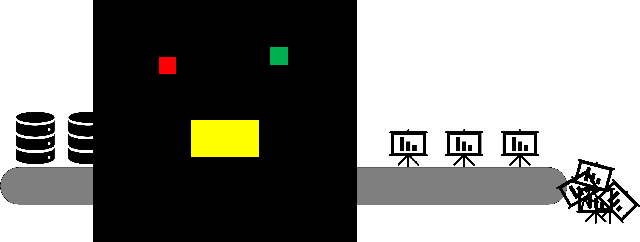
Encapsulation
Reduce product scope
Everything self contained
Single deliverable, single purpose
Reduce change requests
Change log
Isolated deployments
Lower risk
Faster deploys
More throughput (velocity of work)

Slide 6
Product Thinking
Customers
Features
Requests
Feedback
Popularity
Competition
One source of the truth is the enemy of optimisation and evolution
Different people need different truth
Splitting due to different needs
Cost
Value based charging
Easy to see demand justification
Product Managers and Owners

Slide 7
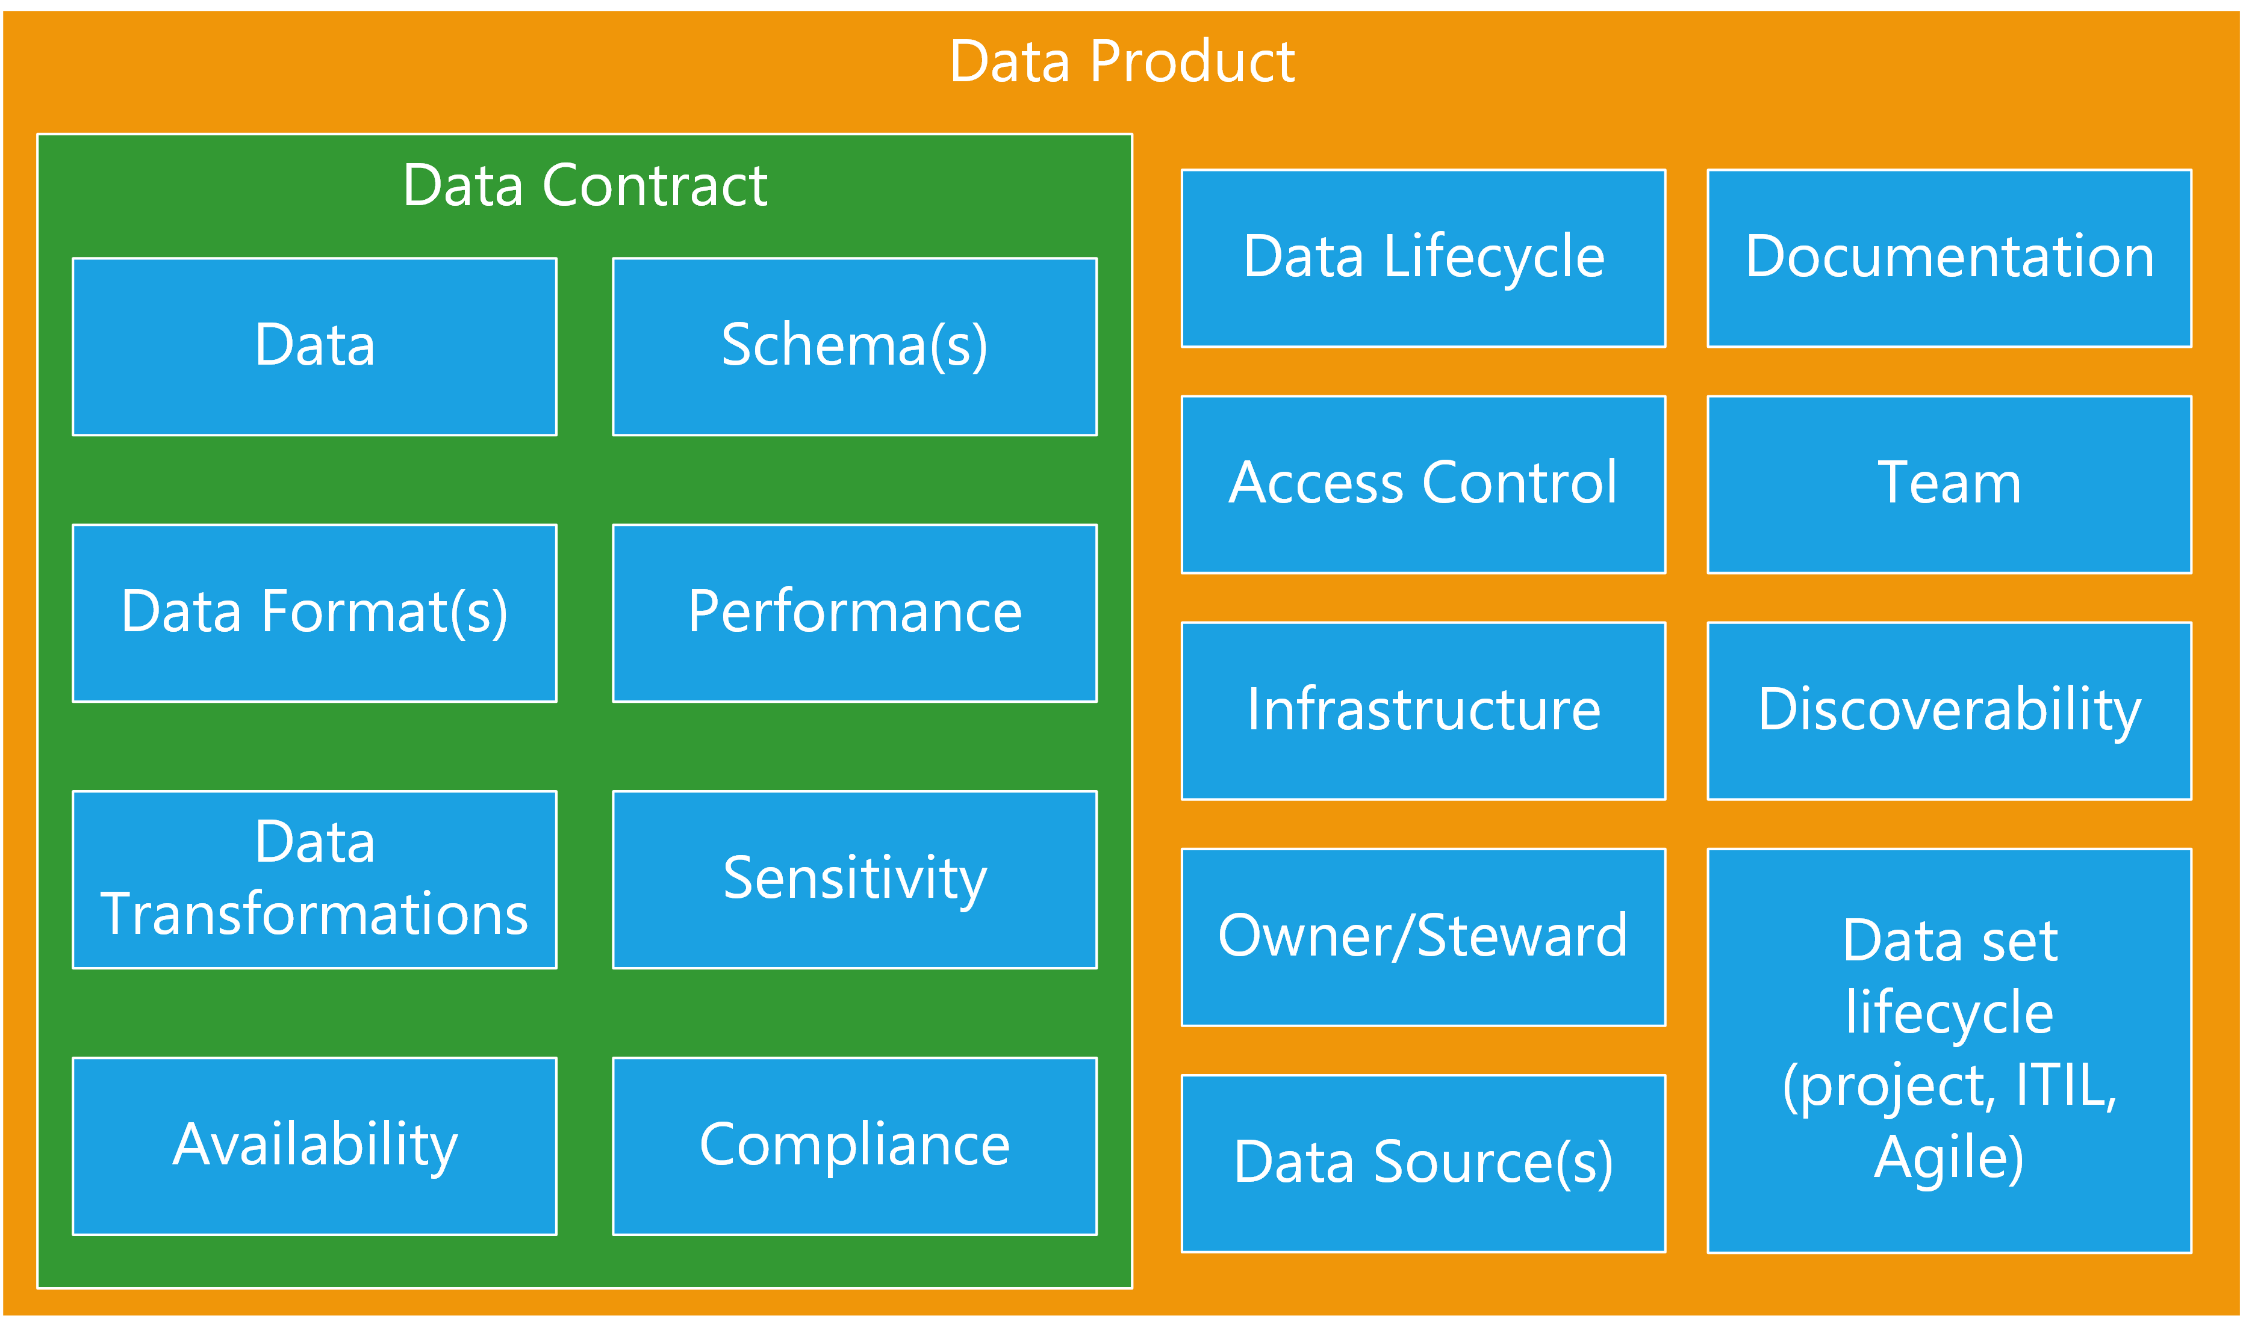
Data Products
Contract
What we deliver
SLAs
Compliance
Ownership
Governance information
Design for discoverability
Include metadata
“Public” Documentation
Catalogues, repositories, libraries, Intranet sites

Slide 8
Decentralise
Decentralisation reduces large complex projects
Feed up the things that are necessary
But do the work locally
Catalogue/data lineage is a good example
Why centralise?
People can discover, NHS is a great example
Lineage can be written into the data, more discoverable and harder to break

Slide 9
Requirements
Rethink what is a real requirement and what is just the way it’s done
Identity
Does it need to be centralised? Introduces change controls and slows progress
Catalog
Does a central catalogue add anything? Sharepoint sites can be more discoverable for real users looking for data
Glossary
Standard words can be useful within a business but don’t scale well and often different BUs use different terms for good reasons. Do we need two weeks of workshops to decide between product, SKU, item, bundle etc. or should we just pick a term and run with it, changing where necessary later

Slide 10
Patterns
A Data platform has no required components
Standardisation and patterns are by definition non-optimal
Good, well documented interfaces between projects
Start from a blank sheet and add what’s needed
Optimise at every step
Use the best tool for the job
Skills are more useful than patterns

Slide 11
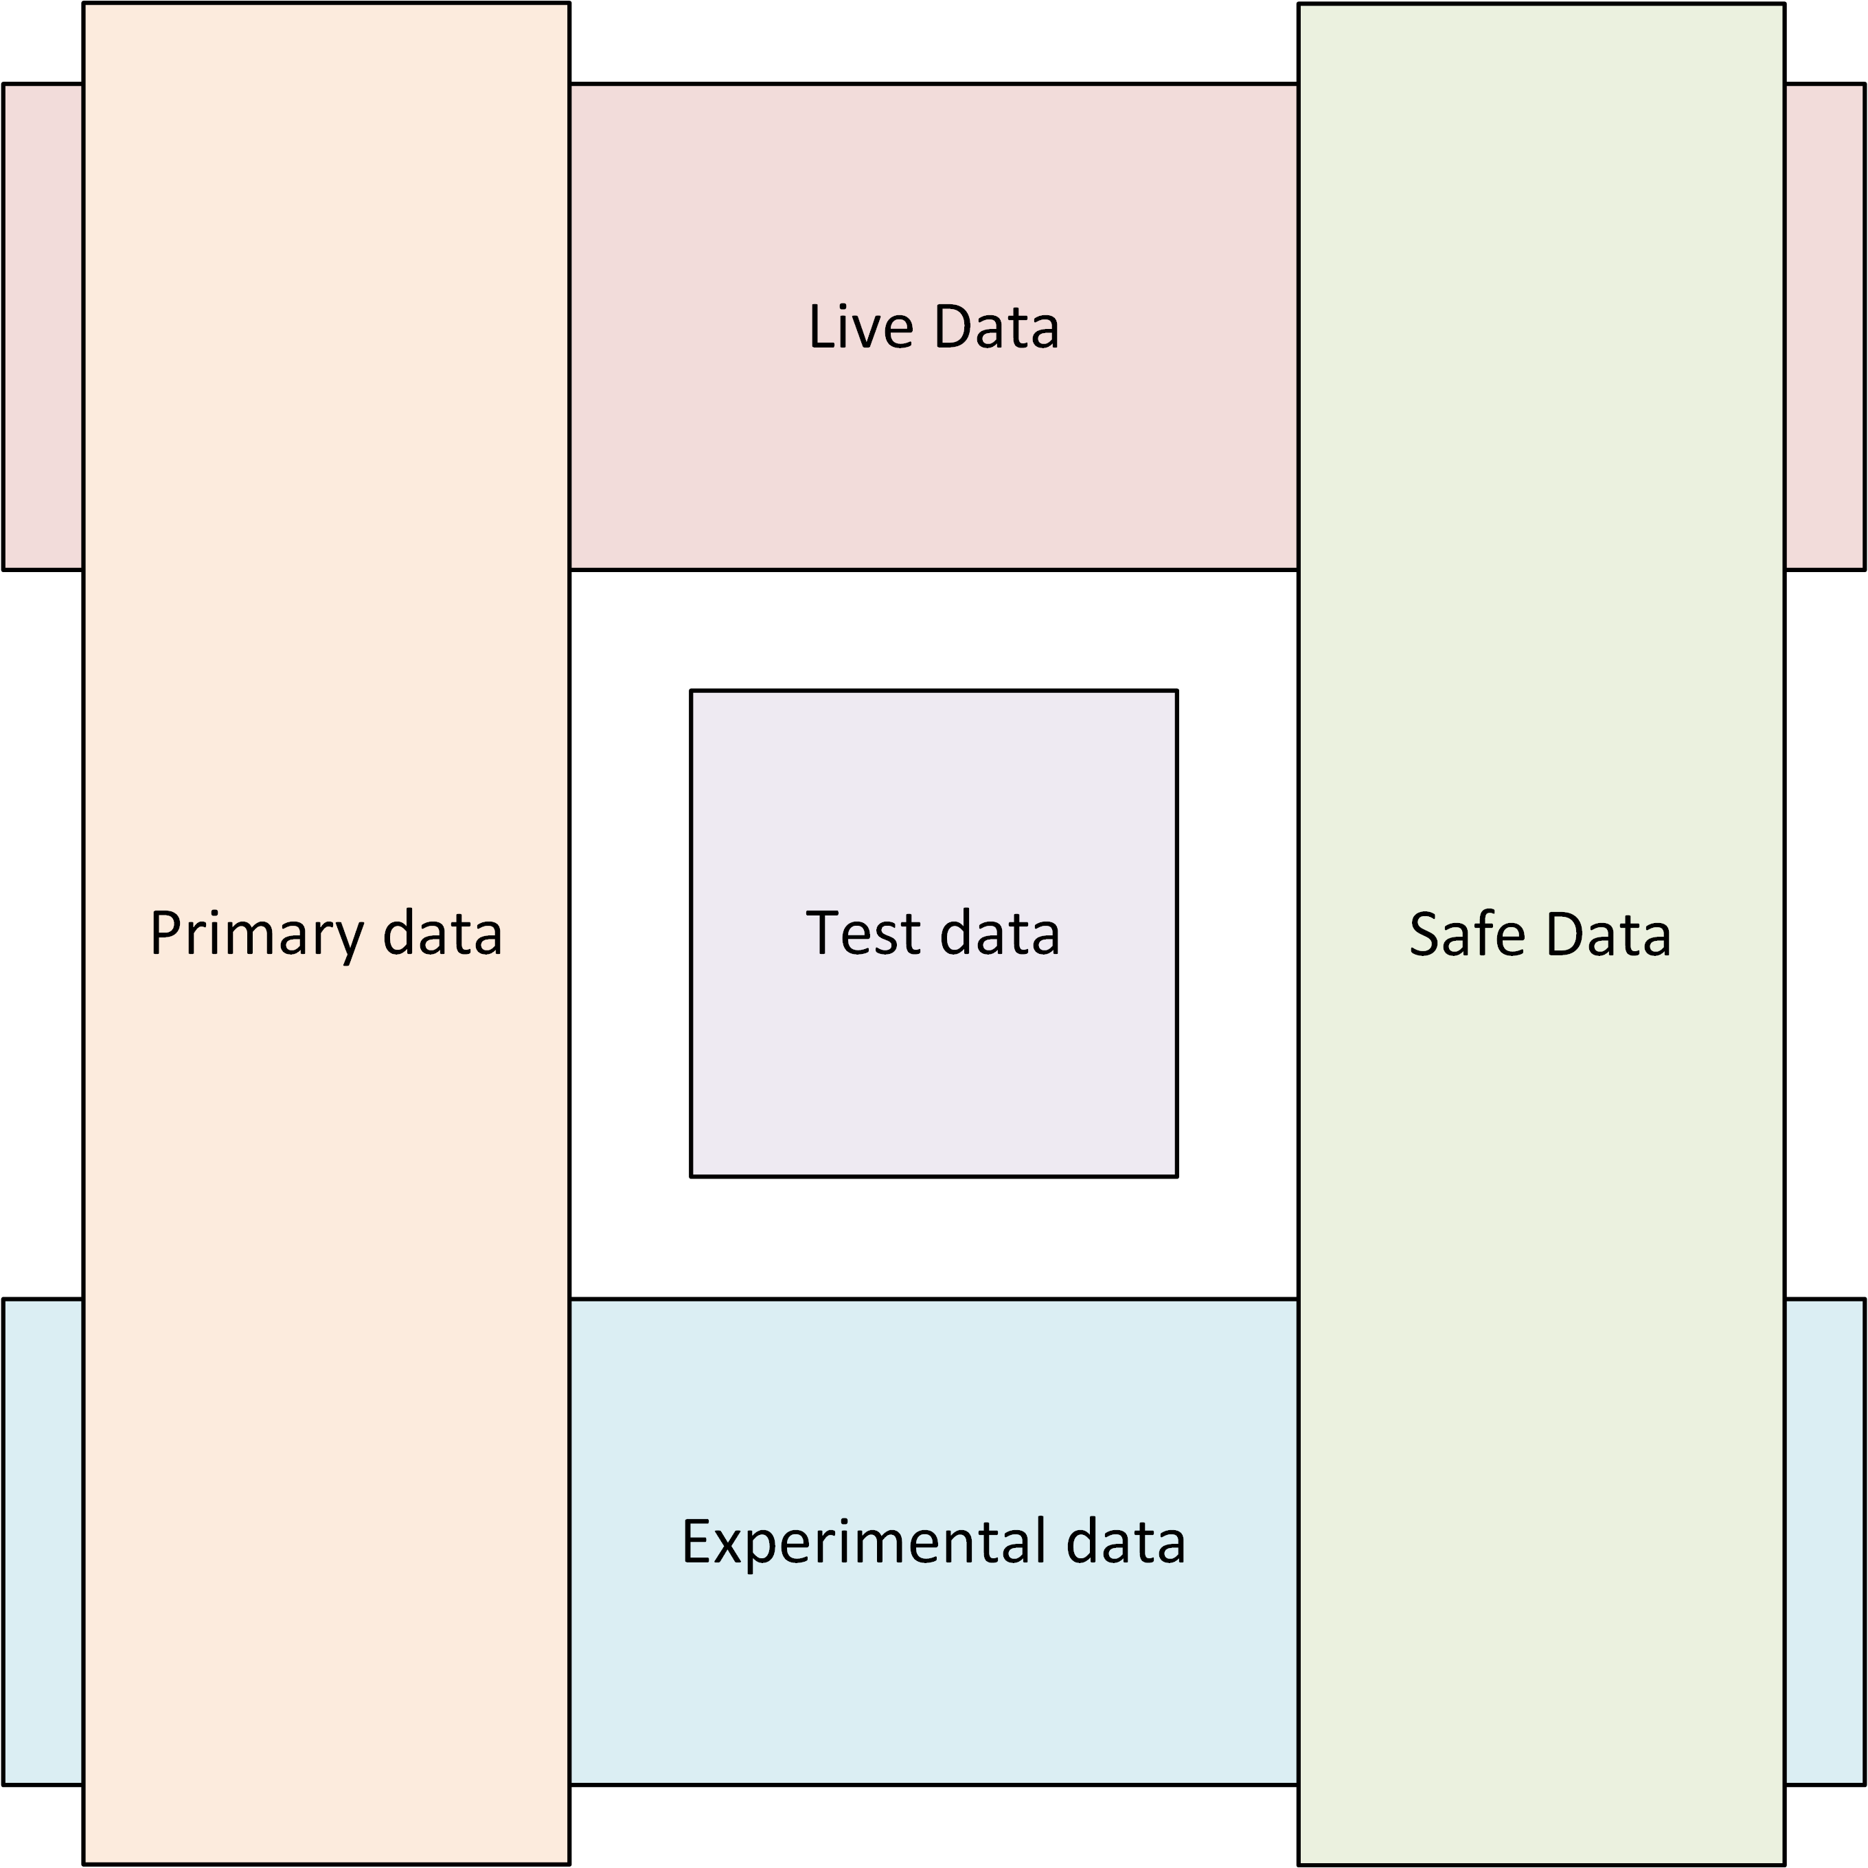
Data Classification vs Staging
Understand what deployment stages are
Dev is where you develop
Test might be ephemeral
Production is the service with SLAs
Understand data classification
Primary data needs controls but can be used everywhere
Safe data needs fewer controls but is less useful
Test data is not derived from primary data
Based on your tests to produce expected results

